Slide 1
MYCOBACTERIUM LEPRAE
Dr. R.S. Gopika M.D. (Hom.)
Professor & Head
Department of Pathology

Slide 2
Sushruta Samhitha - 600 BC
Organism discovered by-
Dr. Armauer Hansen (1873 )
Hansen’s Disease

Slide 3
MORPHOLOGY
Rod - 1 – 8 microns x 0.5 microns.
Pointed ,club end
Acid fast,Gram +ve
Singly,clumps, cigar bundles
Macrophages containing lepra bacilli- Virchow’s lepra cells
Occur intracellularly or extracellularly
target cell- Schwanncell

Slide 4
CULTURE
Not cultivatable in artificial medias or in tissue cultures.
Shepard in 1960- Grown in mice foot pad,
Temp: 20°C
Armidilla’s foot pad
Doubling time-12-13 days
Granuloma develops at the in 1-6 months

Slide 5
It grows best in cooler tissues
-skin [sparing axilla, groin, scalp,
midline of the back], peripheral nerves, anterior chamber of eyes,
upper resp. tract, testis.

Slide 6
Resistance
Warm humid environment-9-16 days
Moist soil-46 days
Direct sun light-2 hrs
UVlight-30 min

Slide 7
Antigenic structure
Cell wall
lipoarabinomannan B layer- mycolic acid- highly immunogenic ,used in serodiagnosis.

Slide 8
MODE OF TRANSMISSION
Nasal droplet
Contact with infected soil
Insect vectors
Direct dermal implantation.
INCUBATION PERIOD
5-7yrs

Slide 9
Portal of entry
Direct inoculation – minute abrasion, cut, mucosa of GIT,RESP tract
blood
target organs

Slide 10
Leprosy is a chronic infectious disease caused by a Mycobacterium leprae affecting especially the skin and peripheral nerves and characterized by the formation of nodules or macules that enlarge and spread accompanied by loss of sensation with eventual paralysis, wasting of muscle, and production of deformities.

Slide 11
Morphological index [MI] –no: of AFB in skin scrapings that stained uniformily bright (viable bacterias)
Bacteriological index [BI]
no: of AFB in tissue both live & dead.
in un treated pts 4+ to 6+
it falls during tt

Slide 12
MB-10 or more bacilli seen in 100 OIF of
a skin slit smear[LL,BL,BB]
Paucibacillary-fewer bacilli less than 10\OIF

Slide 13
Invasion
Disease No disease
[lepromin test positive]
Intermediate form cure
further progress
Lepromatous border line tuberculoid
BL MB BT

Slide 14
PATHOGENESIS
Four ways by which it damages the host
Intra cellular survival- surface phenolic glycolipid resist oxidative killing by macrophages
Peripheral neuritis-due to cell mediated response[T cell]
Bacillary infiltration-except in lungs &CNS
Acute lepra reaction-episode of inflammation in preexisting lesion.

Slide 15
Intermediate leprosy
This type occurs in those whose immunological status has not yet been determined.
It is a transitory phase in the disease process.
The skin lesions consist of hypopigmented macules which are nonspecific in appearance.

Slide 16
PATHOLOGY
Skin –hypopigmented or erythematous macules,wheal like paplules,1-3cm in dia,1-4 in nos
Lepromin test –ve
Microscopical ;
afferent sensory nerve, skin appentages, lymphatics, b.v, in superficial part of dermis are affected
Lymphocytic infilltration
Lesions heal or progress into other forms.

Slide 17
hypopigmented

Slide 18
LEPROMATOUS LEPROSY
Develops in infected persons with low resistance.
Clinicaly.
The skin, nerves, bones and internal organs are involved in this type

Slide 19
LEPROMATOUS LEPROSY
Skin –symmetrical, marginated, multiple infiltrated nodules/leperomata and plaques/ xanthoma like paplues, leonine facies & eyebrow alopecia
Bacilli seen in clumps /globi in blood & nerves
BI-4-6+
Numerous bacilli in skin, nerves, and all organs except lungs and CNS

Slide 20
LL-nerve lesions –late
Nerve enlargement and damage usually symmetric
distal peripheral neuropathy
Due to fibrosis ,nerves can be felt as cords
Microscopical- epidermis atrophied,dense granuloma of foamy cells,
Lymphocytes, clear space b/w epi. & granuloma.
Lepromin test –ve (CMI -low)
Humoralimmune response - M.lepra phenolic glycolipid ab’s- 3+ [95% +]

Slide 21
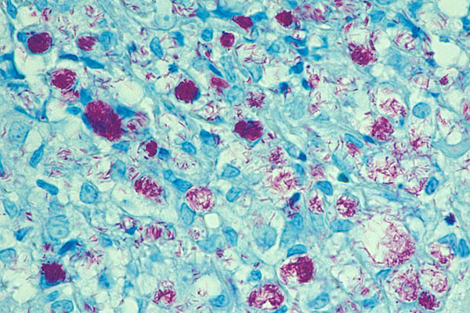
The bacilli are densely clustered within the cytoplasmic vacuoles of foamy macrophages. This unique structure (globi) -Ziehl-Neelsen stain

Slide 22
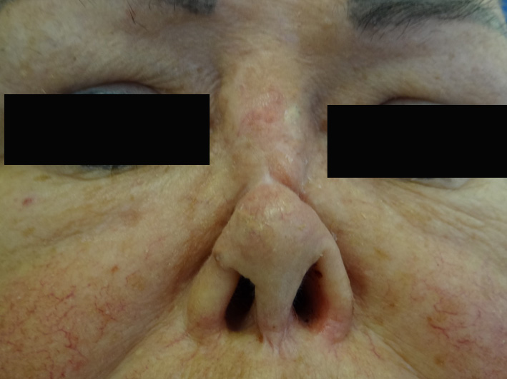
Saddle nose

Slide 23
Leonine face

Slide 24
Other organs involved
liver, testicles, lymph nodes and bones may be involved. Eye affection with keratitis, iridocyclitis and iris atrophy.
Lepromin test is negative, indicating low degree of immunity

Slide 25
TUBERCULOID LEPROSY
Develops in persons with good immunity.
Clinically.
The skin and peripheral nerves are the only tissues showing clinical evidence of involvement
AFB are few or absent.
Lepromin test +ve
BI – 0-1

Slide 26
TL – skin
up to 3 sharply defined asymmetrical macules or plaques with tendency towards central clearing,
elevated borders devoid of hair follicles, dry scaly, anhydrotic or hypohidrotic
lesions -anesthetic early
Least infectious pts.

Slide 27
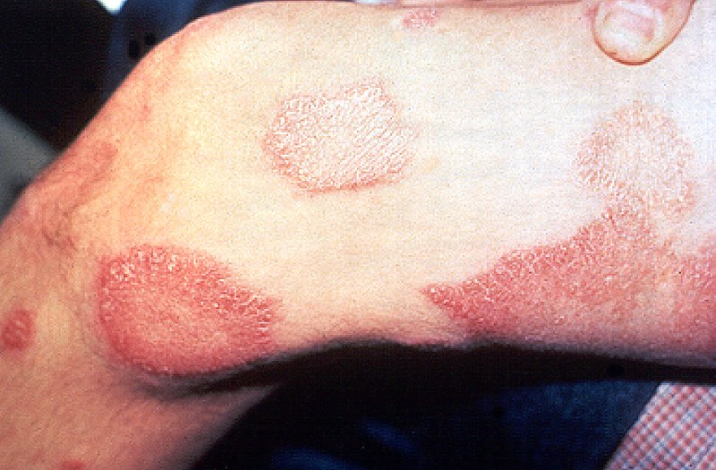
multiple large, annular, hypopigmented, atrophic macules with well-defined, erythematous, raised borders.
The lesions were hairless, hypohidrotic, and anesthetic and had developed at a slow and progressive pace.

Slide 28
TL-nerves
asymmetric enlargement of one or several peripheral nerves—most often the ulnar, posterior auricular, peroneal, and posterior tibial nerves
associated with myopathy.
Microscopic : Nerves completely destroyed, granuloma – epithelioid cells & gaint cells lym at prephery focal lesions undergo caseous necrosis
Lepromin test + ve
.M.lepra phenolic glycolipid Ab’s-1+[60%]

Slide 30
Symptoms
 | Tuberculoid | Borderline Tuberculoid | Borderline Lepromatous | Borderline | Lepromatous
Skin
Infiltrated lesions | Defined plaques, irregular plaques, healing centers | Polymorphic, partially raised edges, satellites | Papules, nodules, punched-out centers | Diffuse thickening | Diffuse thickening
Macular lesions | Single, small | Several, any size | Multiple, all sizes, bizarre | Innumerable, small | Innumerable, confluent
Peripheral Nerve lesions | Solitary, enlarged nerves | Irregular enlargement of several large nerves, asymmetrical patterns | Many nerves involved symmetrical patterns | Late neural thickening, asymmetrical anaesthesia and paresis | Slow, symmetrical ‘glove-and-stocking’ anaesthesia

Slide 31
Complication
Two types
deformities
Allergic /lepra reactions

Slide 32
Deformities
Face : leonine facies ,saddle nose, loss of eye brows .
Hands ; claw hand, wrist drop
Feet : foot drop,clawing of toes, ulcers

Slide 33
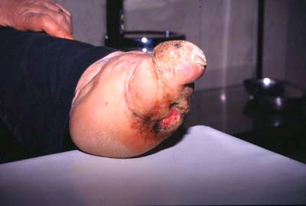
Damage Due to Secondary Infection:

Slide 34
Reactional states/lepra reactions
Type I lepra reaction –
- type IV hypersensitive reaction- inf: in skin lesions
- In LL
- Preceed tt- reversal reaction – to TL
Type II lepra reaction-
- type III hypersensitive reaction- painful erythematous
reaction
- In BL & LL
Lucio’s phenomenon –
- type III hypersensitive reaction- untreated LL

Slide 35
Diagnosis
Leprosy diagnosis is usually made clinically & laboratory testing
Health workers diagnose leprosy based on finding at least one of three cardinal signs of leprosy:
one or more hypopigmented, anaesthetic skin patch.
one or more thickened peripheral nerve
a positive skin smear

Slide 36
Ab to S – 100protein.
Immunostaining with S-100
Serological dia.
Ig M serum Ab’s against glycolipid
Slit-skin test- ear, chin, elbow- tissue fluid is scraped out using scapel & smeared

Slide 37
Stamp preparation of the exudate from the skin incision (skin smear test) can be used for the quick and sensitive diagnosis of leprosy

Slide 38
LEPROMIN TEST
1916 Mitsuda
+ ve test in healthy persons
Principle –delayed hyper sensitivity
Ag - Lepromin H
Lepromin A
rendered non viable by exposing it to
Co 60 radiation .
Contain 160 million bacilli \ ml

Slide 39
.1 ml is injected
Reaction is read at 48 hrs & 21 days
Early reaction [Fernandez reaction]
20 mm dia.
Appear at 24 hrs & dis appear by 3-4 days
Late [Mitsuda]-appear in 7-10 days maximum 3-4 wks, read after 21 days

Slide 40
Siginificance
Classify lesions LL –ve TL- +VE
FER MIT
Induration interpertation Induration interpertation
<5 - ve 0 no reaction
5-10 +/- <3 +/-
10-15 + 3-5 +
15-20 ++ 6-10 ++
>20 +++ 10 ++++

Slide 41
Commons wikimedia.org
Wikimedia common
Robbin’s &Cotran Pathologic Basis Of Disease -8th Edition
Text Book of Microbiology-Anandanarayanan

